Slide 1
SOEN 6841 SOFTWARE PROJECT MANAGEMENT-Version B
Sprint 1 Demo – Team G
Presenter Name | Presenter ID
Nivetha Ravi | 40085910
Hina Masood Ahmed | 40076287
Sahana Shankar | 40092026
Shruthi Kondapura Venkataiah | 40091427
Anusha Keralapura Thandavamurthy | 40102962
Surya Prakash Govindaraju | 40085527

Slide 2
OBJECTIVES
Making an application accessible to a broader community.
Application must be text free and must support low literate people.
Goal is to collect narrative story about health condition.
Collection of data by asking few sets of predefined questions.
Text-free by using voice for feedback and navigation, and symbols for the buttons which functionality should be easy to understand or figure out by users

Slide 3
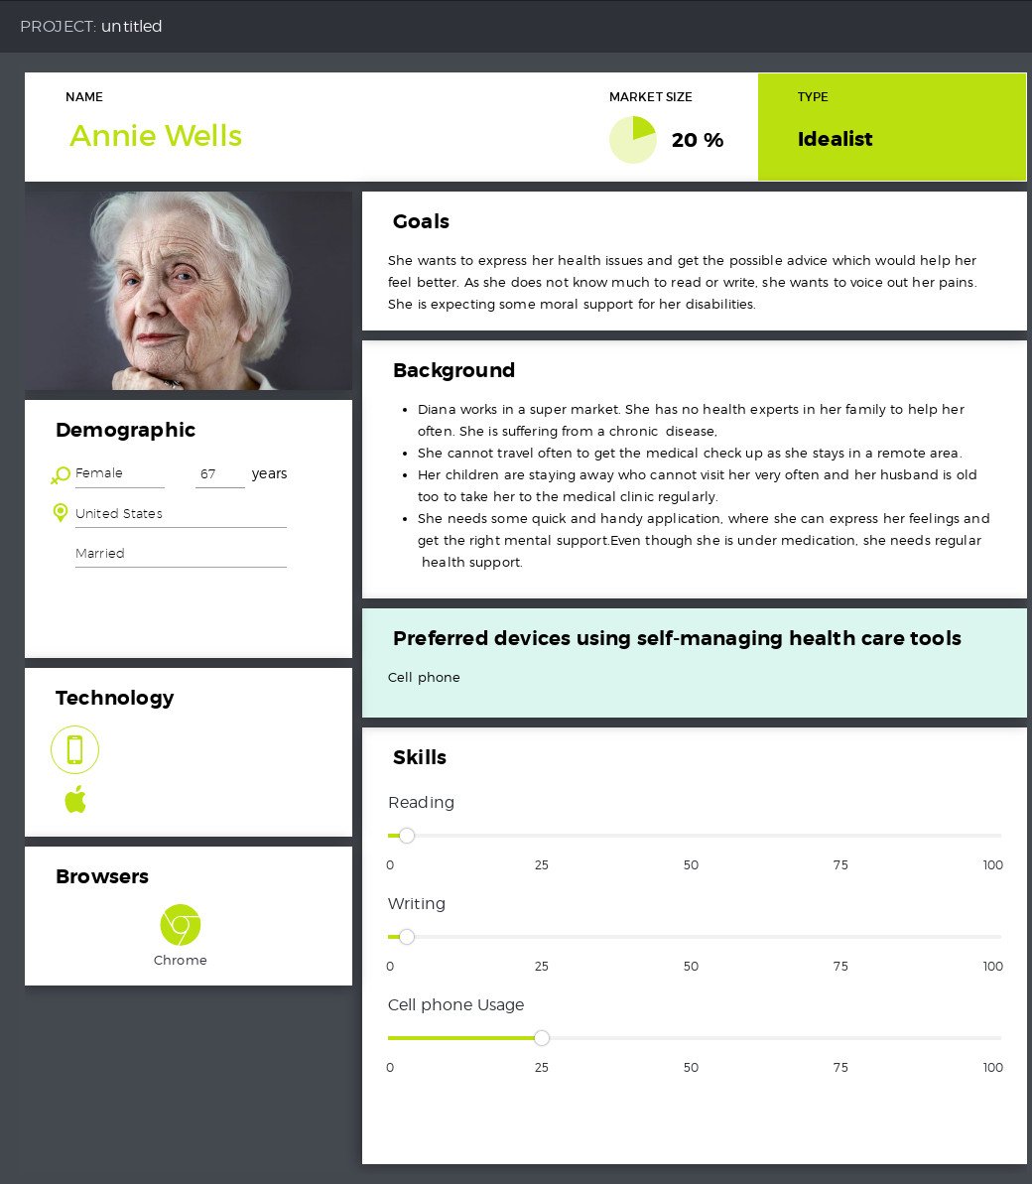
Persona
Describe the Characteristics of a typical Application user .
Provides information about age, gender , socio-economic background

Slide 4
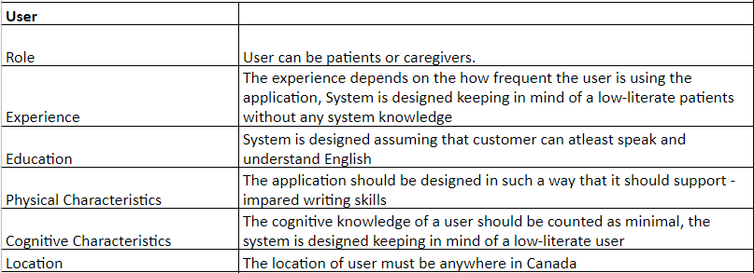
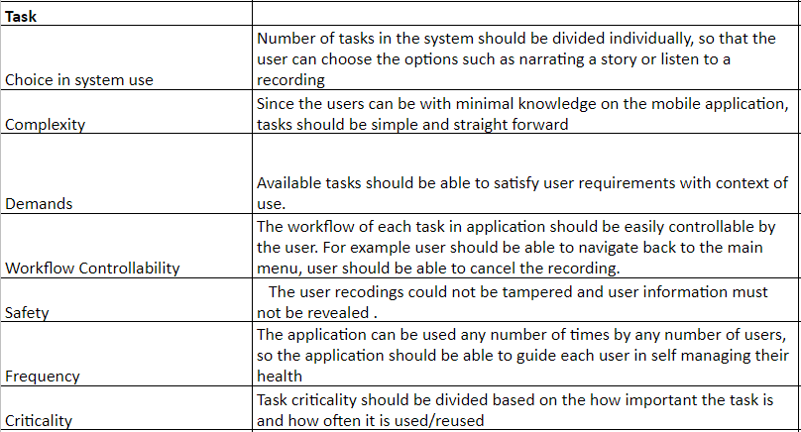
Context of Use

Slide 5
User Story Backlog & Planning
ID | User Stories | Sprint
MP_US1 | As a user, I should be able to see all the options on the Home screen to use the application | S1
MP_US2 | As a user, I should be able to navigate from any screen to Home screen so that I would be able to see the list of Menu available. | S1
MP_US3 | As a user, i should be able to hear a set of questions so that I can understand what is being asked. | S1
MP_US4 | As a User, I should be able to record my answer to particular question so that my answers are recorded. | S1
MP_US5 | As a user, I should be able to hear the options available to navigate so I can understand to perform required actions. | S1
MP_US6 | As a user, I should be able to submit my narrated stories, so my stories are saved. | S1
MP_US7 | As a user, I can review my narrated story so that I can make decision to submit or not. | S1
MP_US8 | As a user, i want to see list of Stories so i can access all the recorded narrated stories by others. | S2
MP_US9 | As a user, i can click on any particular story so that i can listen to them. | S2

Slide 6
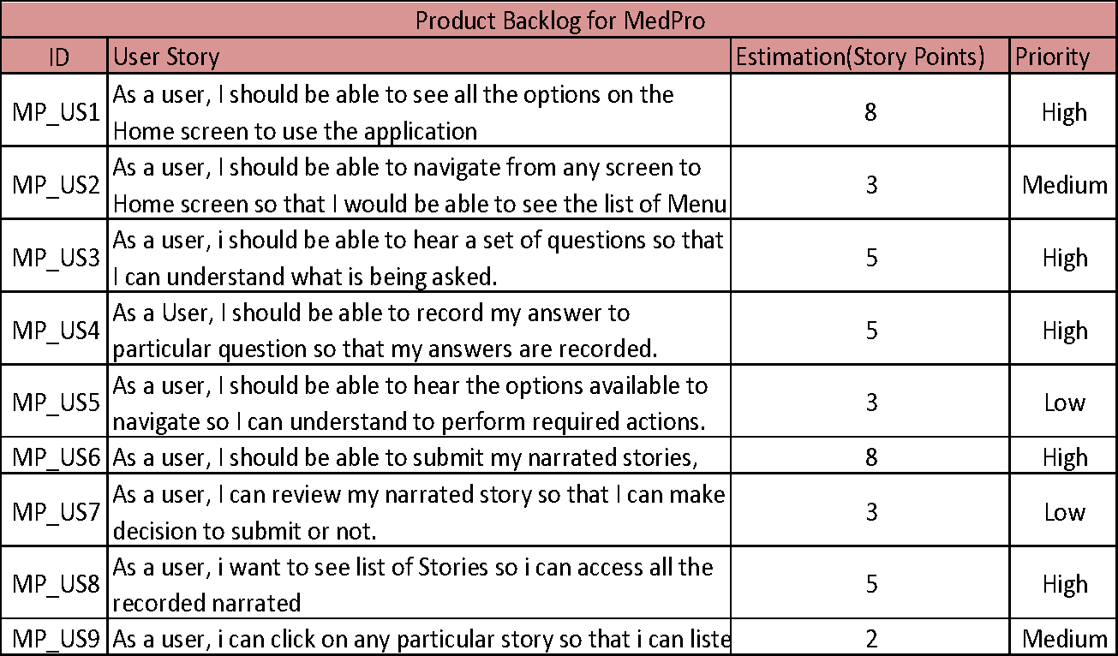
Estimation of User Stories using Planning Poker Technique
** Using Planning poker estimation, the user stories were estimated by team members considering MP_US4 as a average which is 5 Story points **
** User stories are prioritized based on the business value**

Slide 7
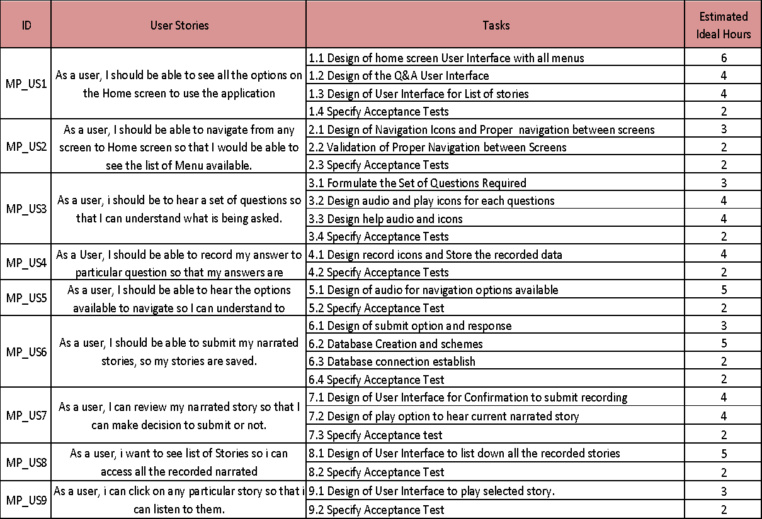
User Story into Tasks

Slide 8
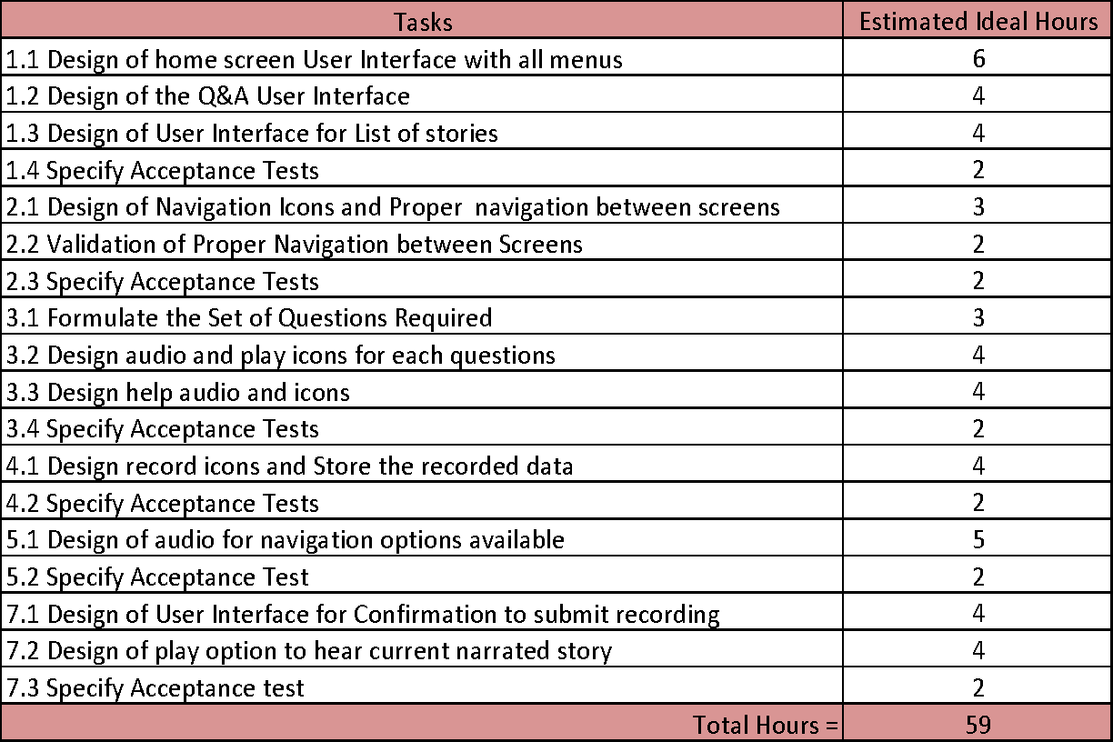
Sprint 1 Tasks Estimation
Miscellaneous Tasks -
1. Creation of Persona
2. Creation of narrated story board
3. Creation of product backlog and estimation of each user stories
4. Usability Testing
The Tasks for Sprint1 is considered based on the Scope assessment. where in on an average, each person in team works 10 hours per week.
Number of resources = 6
Productive Effort per week = 4-5 hrs
Each Iteration is 2 weeks, therefore available hours between 6*4*2 to 6*5*2
i.e.. 48 to 60 hours.
* Productive effort doesn't include time spent on meetings, discovery and others..

Slide 9
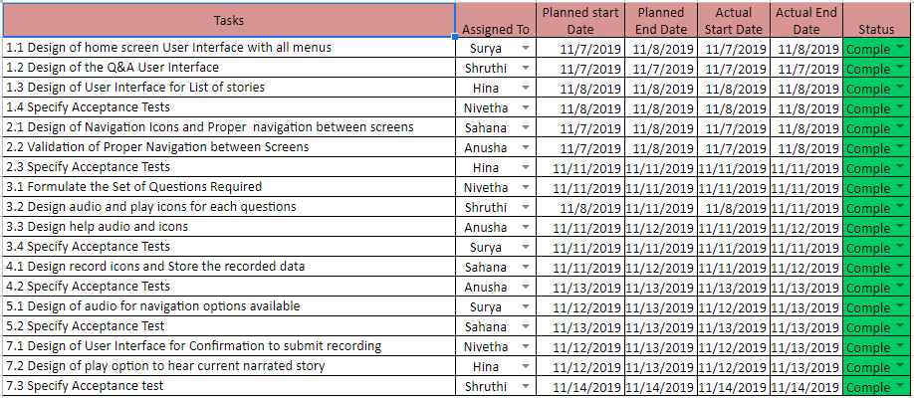
Sprint 1 Planning

Slide 10
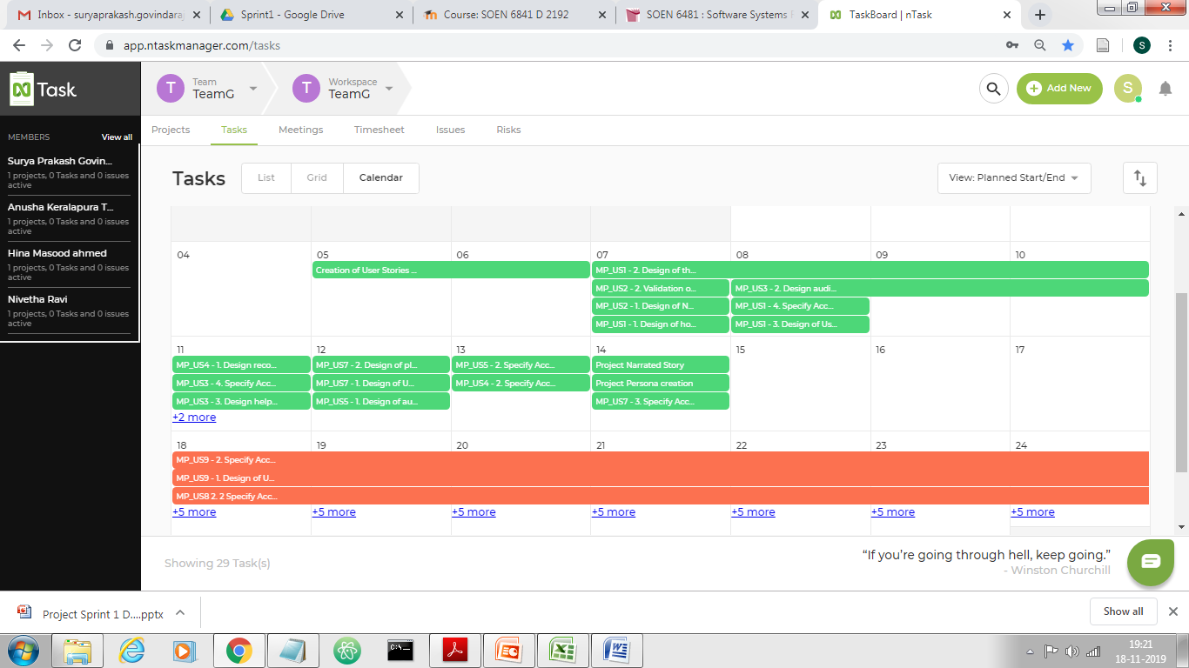
Task Management Tool
For tracking and management purpose we have used Task Board tool.

Slide 11
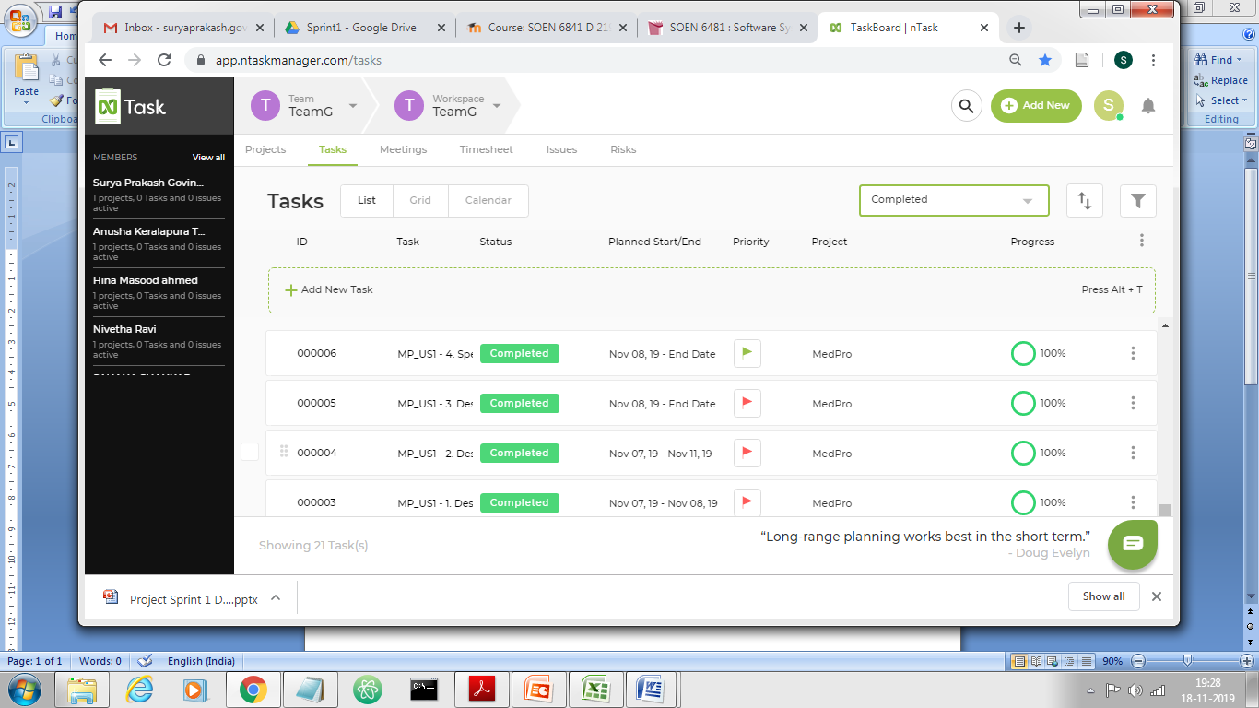
Task Management Tool

Slide 12
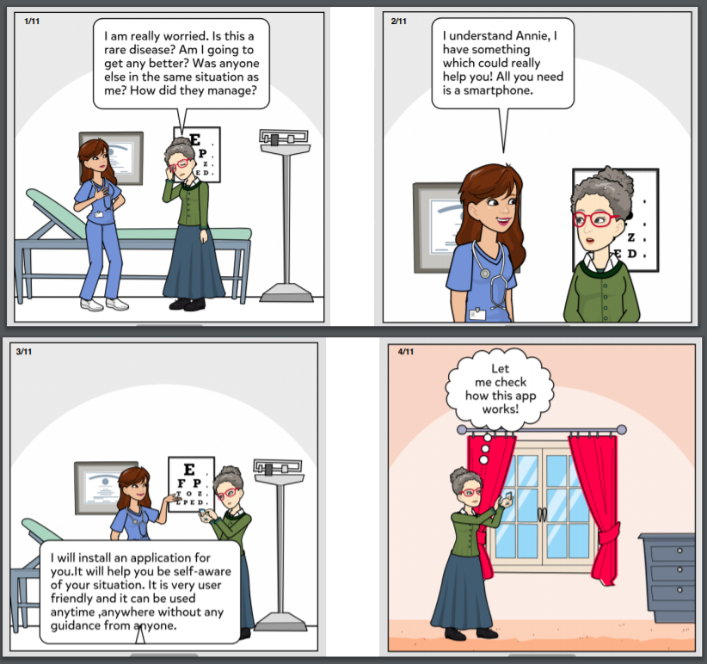
User Story Board

Slide 13
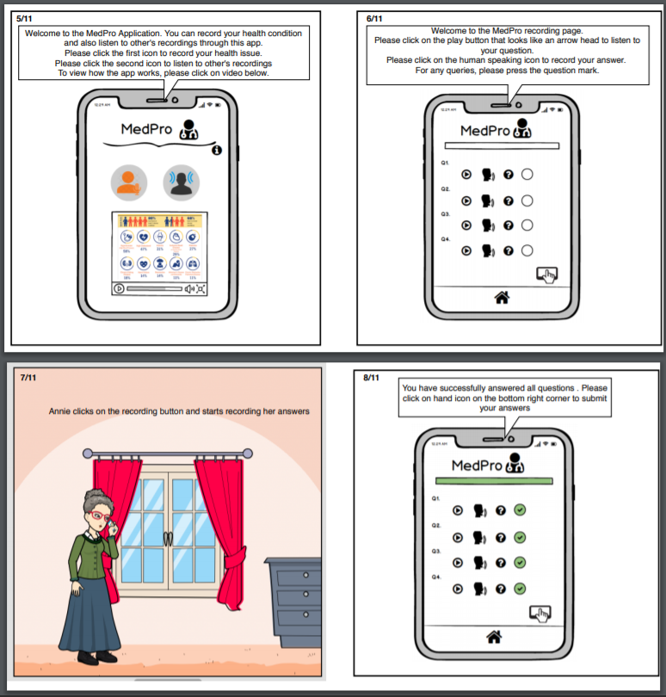
User Story Board (continued..)

Slide 14
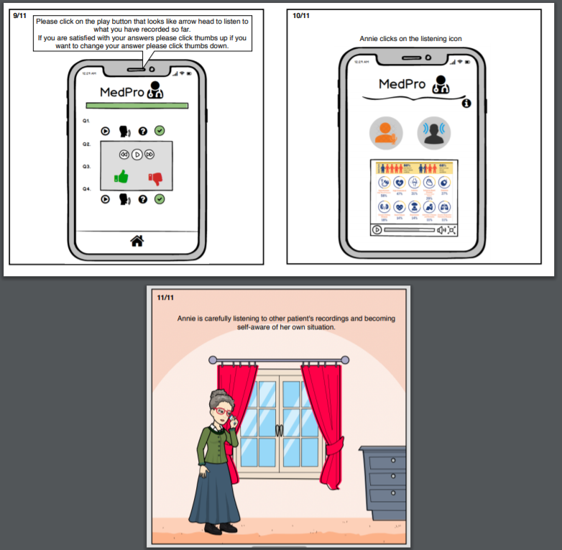
User Story Board (continued..)

Slide 15
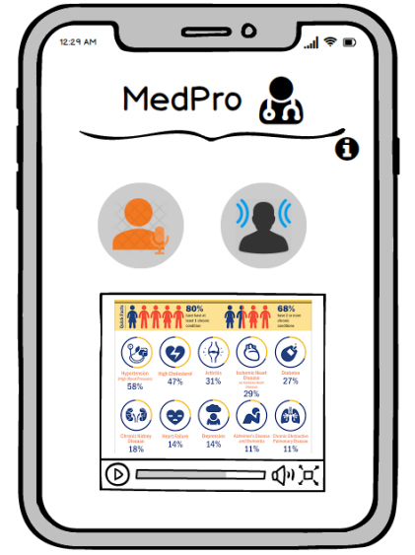
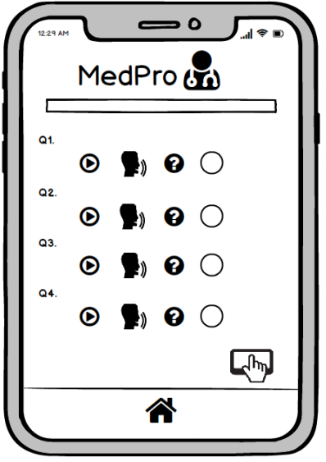
Prototype Screen

Slide 16
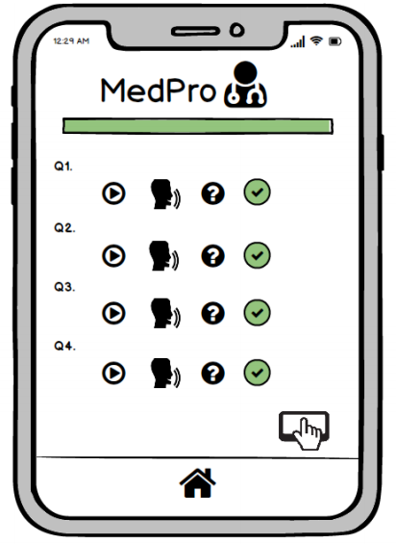
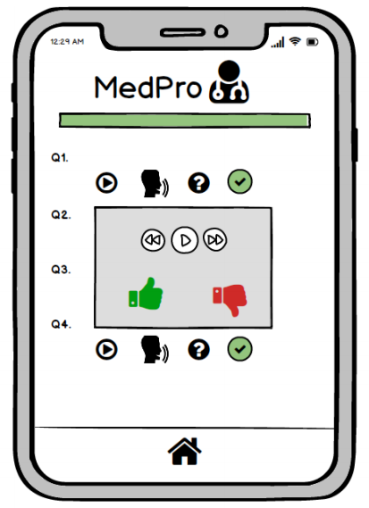
Prototype Screen - contd.

Slide 17
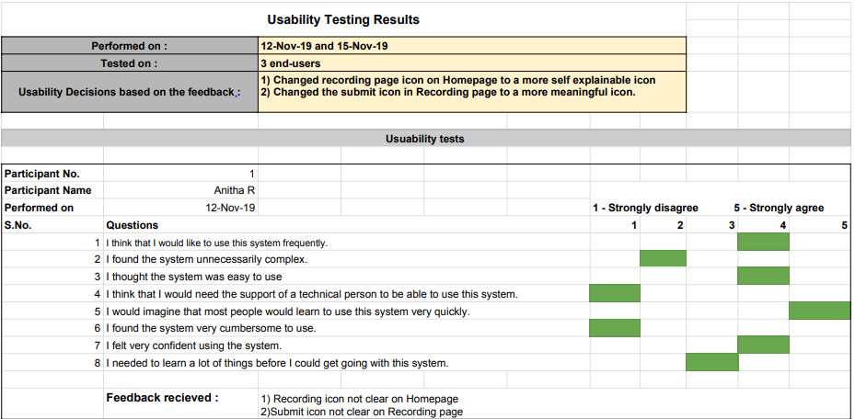
Usability Testing & Feedback

Slide 18
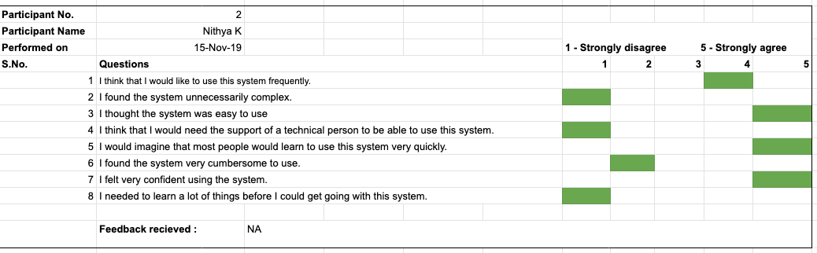
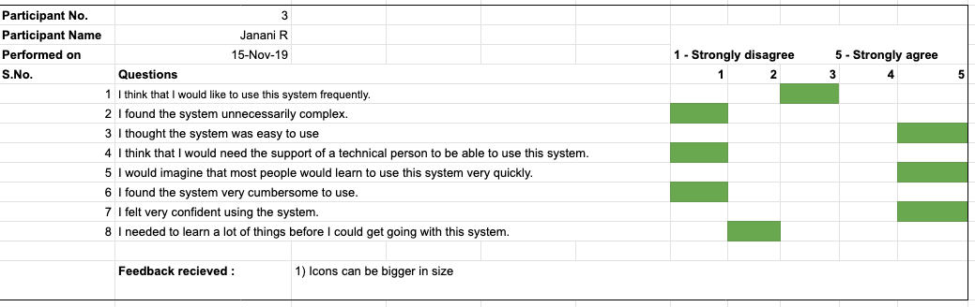
Usability Testing & Feedback

Slide 19
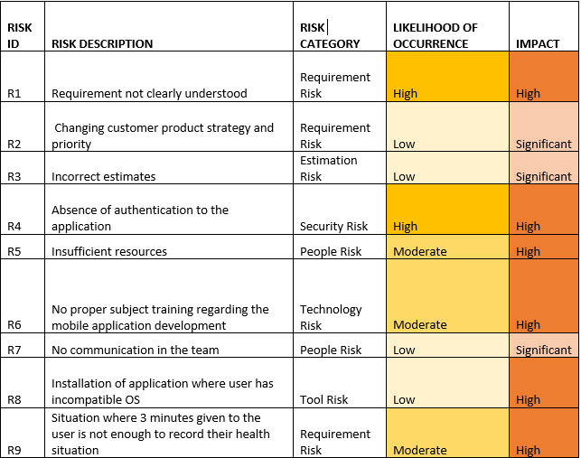
Risk Management for Features Developed in Sprint 1

Slide 20
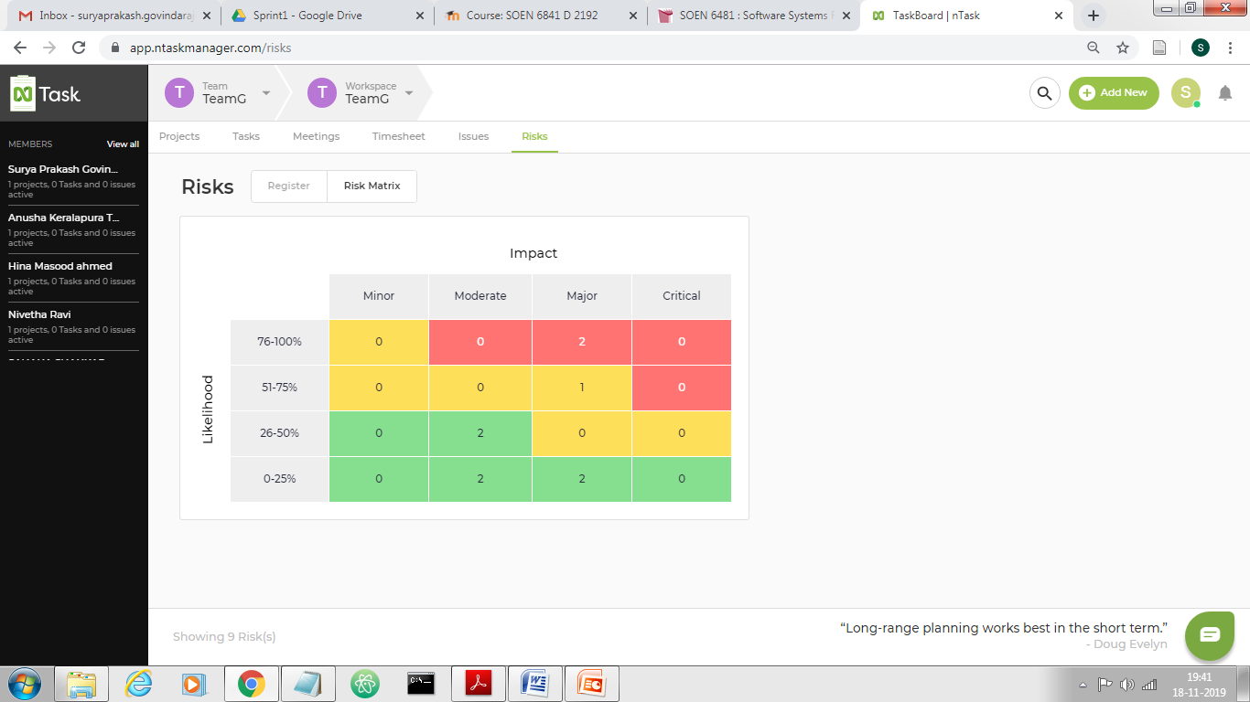
Risk Matrix

Slide 21
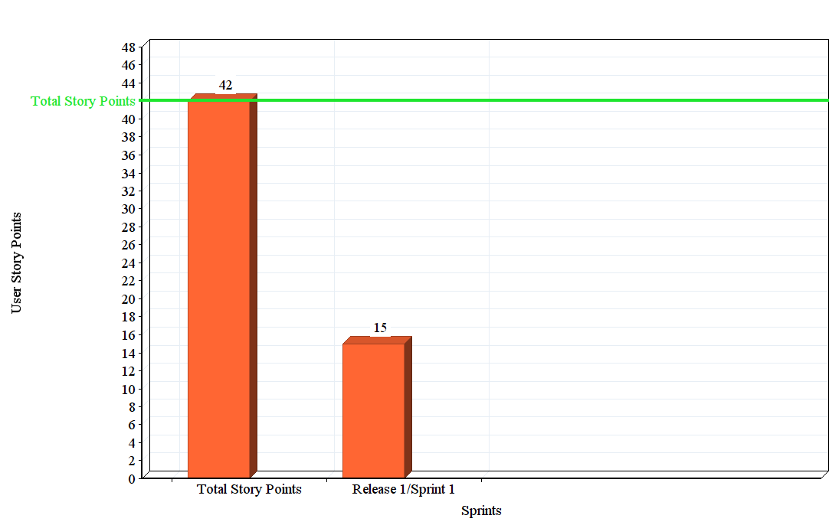
RELEASE BURN DOWN CHART
Total - 42 Story Points
In Sprint 1, team has completed 27 story points as planned.
Remaining 15 story points are expected to complete in sprint 2

Slide 22
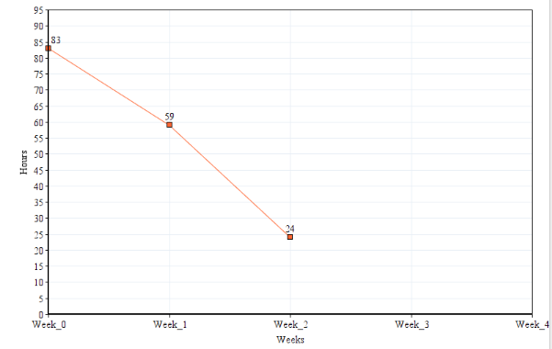
Iteration Burn Down Chart
Total – 83 Productive effort hours
In Week1, team has completed 24 hours therefore 59 hours is the remaining efforts
In Week2, team has completed 25 hours therfore 24 hours is remaining efforts.

Slide 23
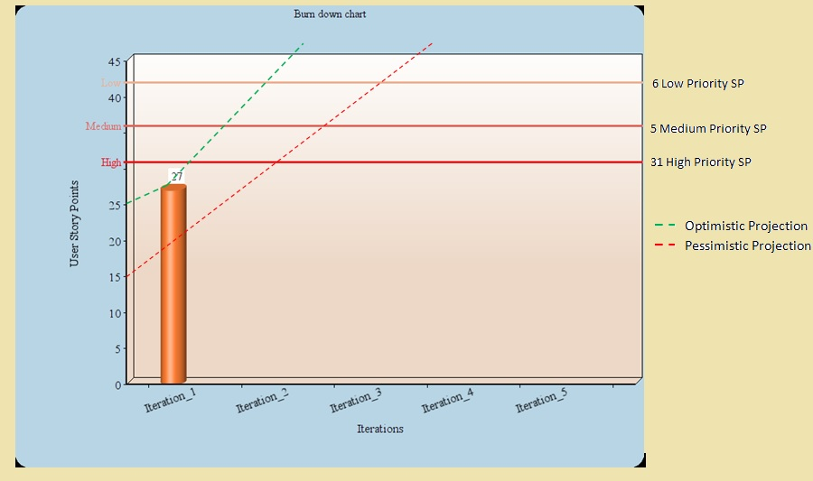
SUNSET GRAPH

Slide 24
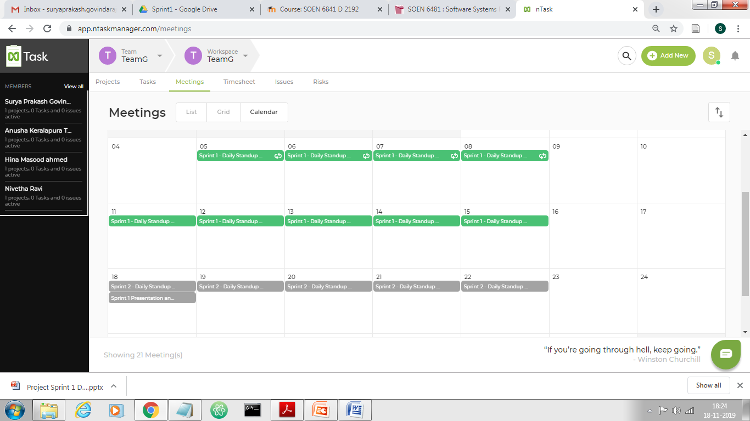
Daily Stand Up Meeting
Daily Standup meeting were scheduled using the task board tool and all team member were part of the meeting.
Minutes of Meeting of each meeting is recorded and captured (refer : MOM-SPM.doc)

Slide 25
Supporting Documents
Team G – User-Stories BackLog
Team G – Sprint 1 & 2 Planning
Application-Prototype Screens
Team G – Med-Pro Storyboard
Team G – Context of Use & Persona
Team G – Minutes of the Meeting
Team G - Risk Management
Unit Test cases
Usability Testing
Acceptance Test cases
Release, Iteration Burndown & Sunset-Graph Charts

Slide 26
Thank You

